Slide 1
Cognition and Conditioning
Conditioning with probabilistic generative models

Slide 2
Conditional inference
The book describes conditional inference as the thinking about how causes gave rise to a specific, observable result or event
They mention, that much of cognition can be described in terms of conditional inference. So apart from mere conditional inference, predictions are nothing else, than conditional inference in the opposite direction. Predictions take in account some known facts and guess what is likely to come out of those.
Many human behaviours and actions like learning are also linked to conditional inference

Slide 3
Conditional inference and its use

Slide 4
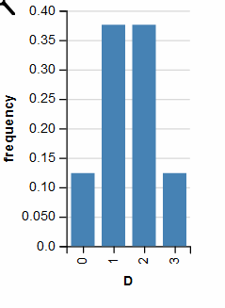
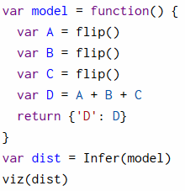
Hypothetical Reasoning with Infer
What we did so far !

Slide 5
Set up a base to use infer for conditioning:
Rejection sampling
Using conditional distribution, bayes rule
Other Implementations

Slide 6
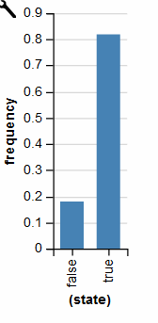
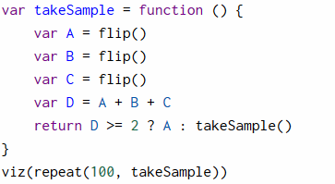
Rejection Sampling

Slide 7
Conditional distribution, Bayes-theorem
Conditional distribution
Bayes-theorem

Slide 8
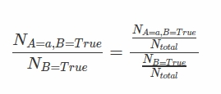
Comparison: conditional distribution – rejection sampling
The number of total samples defines the precision of rejection sampling:

Slide 9
Other possibilities for sampling
Some other available options for Infer-methods:
MonteCarloMarkovChain (MCMC)
SequentialMarkovChain (SMC)
- Others

Slide 10
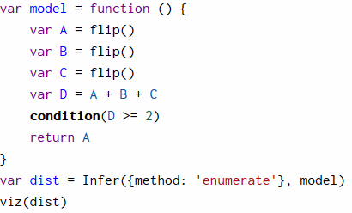
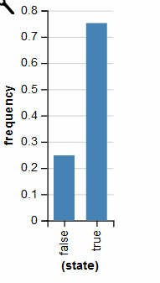
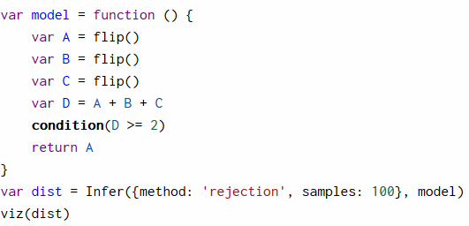
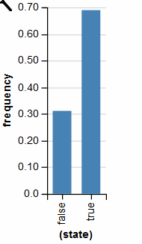
Infer with different methods
Infer with conditional distribution
Infer with rejection sampling

Slide 11
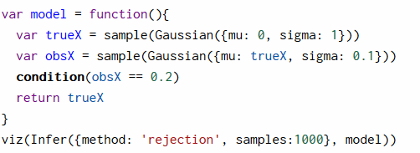
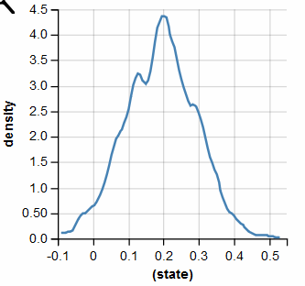
condition() vs. observe()
condition():
observe():
Does never terminate !

Slide 12
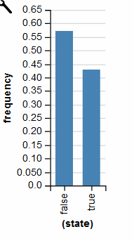
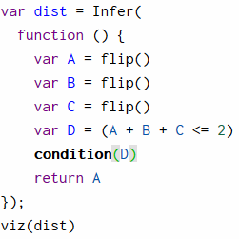
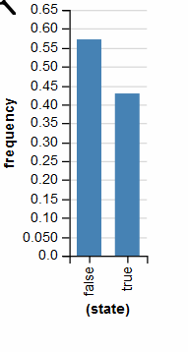
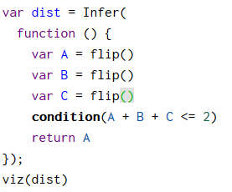
condition() is powerful

Slide 13
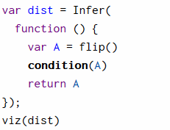
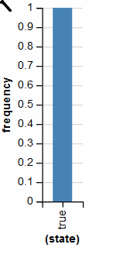
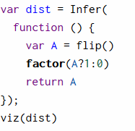
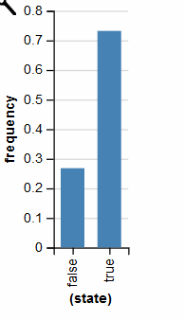
factor() as an alternative to condition()
condition()
factor()

Slide 14
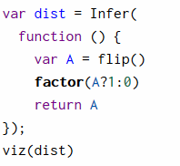
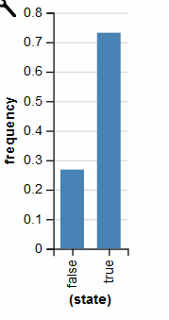
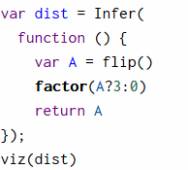
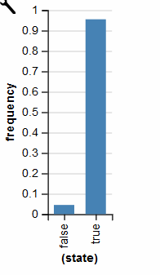
factor() in detail
factor(A ? 1:0)
factor(A ? 3:0)

